Slide 1
Search Engine Basics

Slide 2
Topics Covered
Search Engine Results Pages (SERPs)
Algorithm-Based Ranking Systems: Crawling, Indexing, and Ranking
Evaluating Content on a Web Page
Understanding What Content Search Engines Can “See” on a Web Page

Slide 3
Search Engine Results Pages (SERPs) (1)
In the search marketing field, the pages the engines return to fulfill a query are referred to as search engine results pages (SERPs).
Each engine returns results in a slightly different format, and these may include vertical results—results that can be derived from different data sources or presented on the results page in a different format.

Slide 4
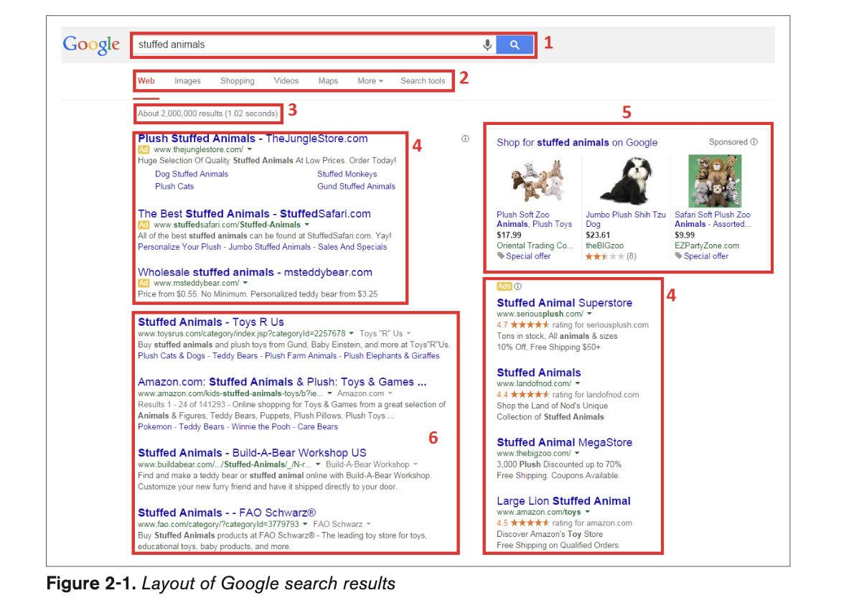
Search Engine Results Pages (SERPs) (2)
The various sections outlined in the Google search results are as follows:
Search query box (1)
Vertical navigation (2)
Results information (3)
PPC advertising (4)
Google product search results (5)
Natural/organic/algorithmic results (6)

Slide 5
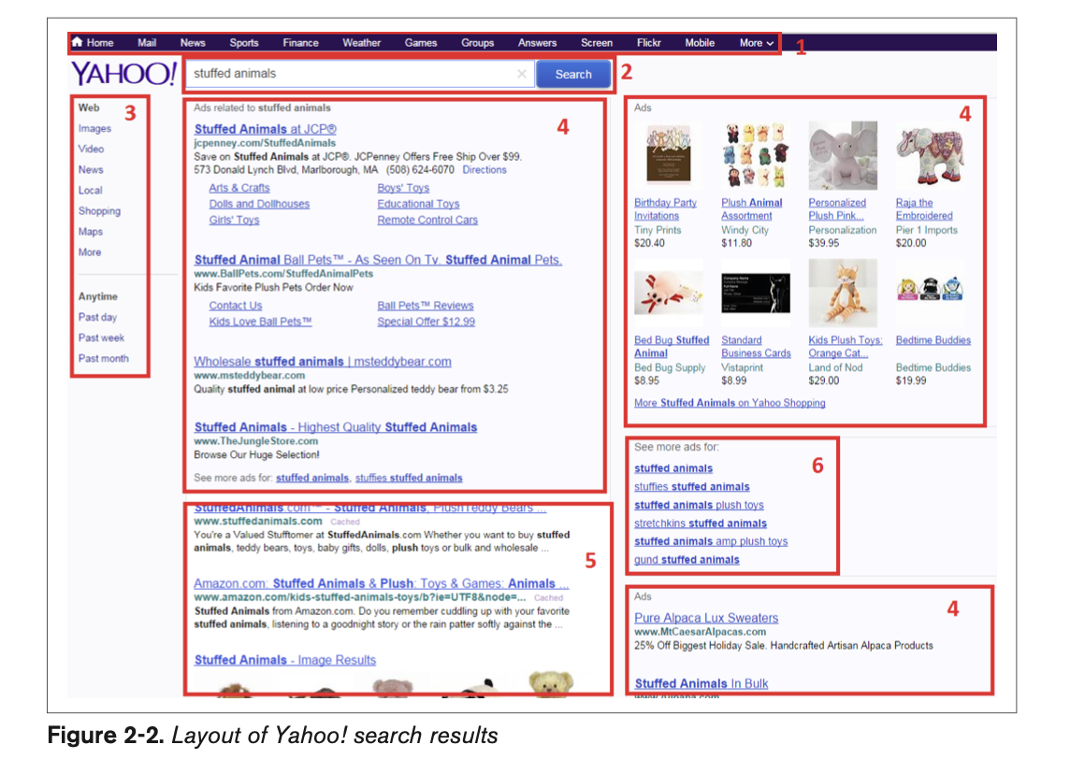
Search Engine Results Pages (SERPs) (2)
Even though Yahoo! no longer does its own crawl of the Web or provides its own search results information (it sources them from Bing), it does format the output differently (as shown in Fig 2.2)
The sections in the Yahoo! results are as follows:
• Vertical navigation (1) • Search query box (2) • Horizontal navigation (3) • PPC advertising (4) • Natural/organic/algorithmic results (5)
• Navigation to more advertising (6)

Slide 6
SERP (1)
Each unique section represents a snippet of information provided by the engines. Here are the definitions of what each piece is meant to provide:
Vertical navigation: Each engine offers the option to search different verticals, such as images, news, video, or maps. Following these links will result in a query with a more limited index
Horizontal navigation : All three engines used to have some form of horizontal navigation, but as of June 2015 only Yahoo! continues to include it.
Search query box : All of the engines show the query you’ve performed and allow you to edit or reenter a new query from the search results page. If you begin typing, you may notice that Google gives you a list of suggested searches below. This is the Google autocomplete suggestions feature, and it can be incredibly useful for targeting key- words. Next to the search query box, the engines also offer links to the advanced search page.

Slide 7
SERP (2)
Results information : This section provides a small amount of meta-information about the results that you’re viewing, including an estimate of the number of pages relevant to that particular query (these numbers can be, and frequently are, wildly inaccurate and should be used only as a rough comparative measure).
PPC (a.k.a. paid search) advertising : The text ads are purchased by companies that use either Google AdWords or Bing. The results are ordered by a variety of factors, including relevance (for which click-through rate, use of searched keywords in the ad, and relevance of the landing page are factors in Google) and bid amount (the ads require a maximum bid, which is then compared against other advertisers’ bids).
Natural/organic/algorithmic results : These results are pulled from the search engines’ primary indices of the Web and ranked in order of relevance and importance according to their complex algorithms. This area of the results is the primary focus of this section of the book.

Slide 8
SERP (3)
Query refinement suggestions: Query refinements are offered by Google, Bing, and Yahoo!. The goal of these links is to let users search with a more specific and possibly more relevant query that will satisfy their intent.
Navigation to more advertising : Only Yahoo! shows this in the search results. Clicking on these links will bring you to additional paid search results related to the original query.

Slide 9
Algorithm-Based Ranking Systems: Crawling, Indexing, and Ranking (1)
Understanding how crawling, indexing, and ranking works is useful to SEO practitioners, as it helps them determine what actions to take to meet their goals.
This section primarily covers the way Google and Bing operate, and does not necessarily apply to other search engines that are popular in other countries, such as Yandex (Russia), Baidu (China), Seznam (Czech Republic), and Naver (Korea).

Slide 10
Algorithm-Based Ranking Systems: Crawling, Indexing, and Ranking (2)
The search engines must execute many tasks very well to provide relevant search results. Put simplistically, you can think of these as:
Crawling and indexing trillions of documents (pages and files) on the Web (note that they ignore pages that they consider to be “insignificant,” perhaps because the pages are perceived as adding no new value or are not referenced at all on the Web).
Responding to user queries by providing lists of relevant pages.

Slide 11
Crawling and Indexing (1)
Crawling and Indexing : To offer the best possible results, search engines must attempt to discover all the public pages on the World Wide Web and then present the ones that best match up with the user’s search query. The first step in this process is crawling the Web.
The search engines start with a seed set of sites that are known to be very high quality, and then visit the links on each page of those sites to discover other web pages.
The link structure of the Web serves to bind together all of the pages that were made public as a result of someone linking to them.
Through links, search engines’ automated robots, called crawlers or spiders, can reach the many trillions of interconnected documents.

Slide 12
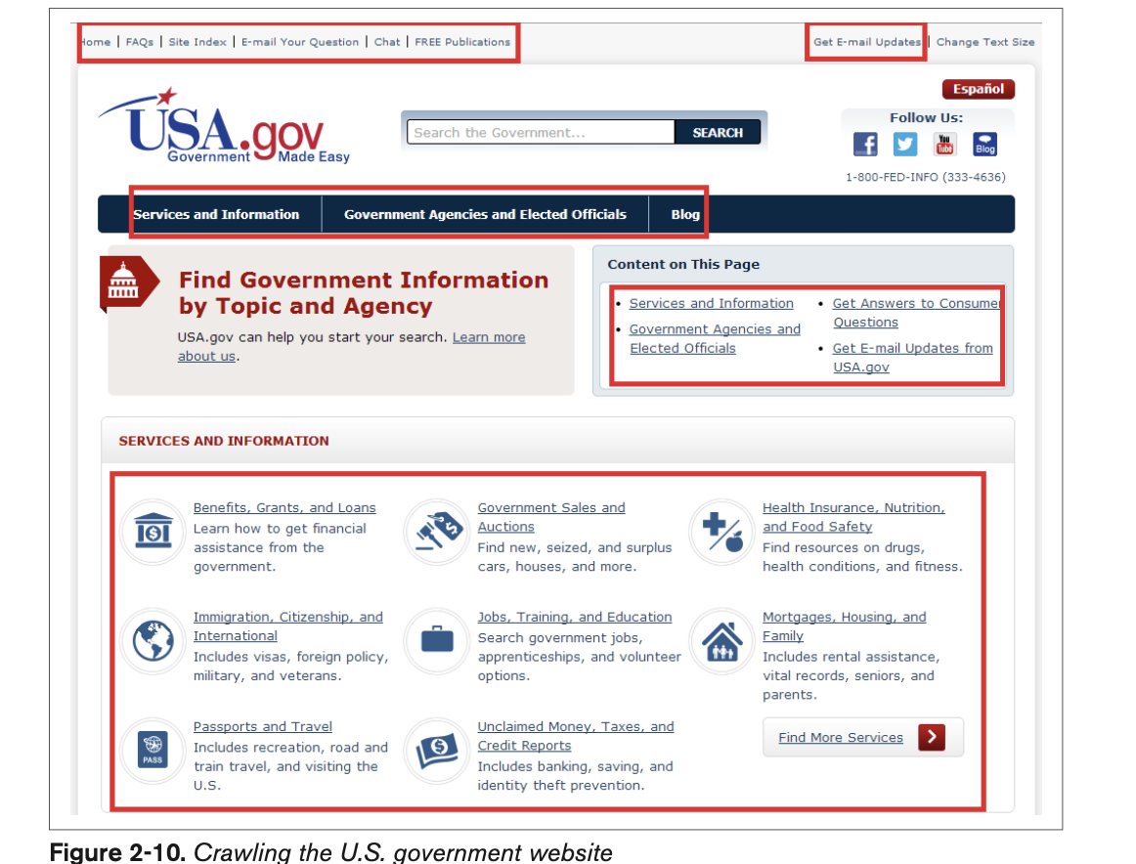
Crawling and Indexing (2)
In Figure 2-10, you can see the home page of USA.gov, the official U.S. government website.
The links on the page are outlined in red.
Crawling this page would start with loading the page, analyzing the content, and then seeing what other pages USA.gov links to.
The search engine would then load those other pages and analyze that content as well.
This process repeats over and over again until the crawling process is complete.
This process is enormously complex, as the Web is a large and complex place.

Slide 13
Crawling and Indexing (3)
“Search engines do not attempt to crawl the entire Web every day. In fact, they may become aware of pages that they choose not to crawl because those pages are not likely to be important enough to return in a search result. The role of importance can be discussed under “Retrieval and Ranking” ”
The first step in this process is to build an index of terms. This is a massive database that catalogs all the significant terms on each page crawled by the search engine.
A lot of other data is also recorded, such as a map of all the pages that each page links to, the clickable text of those links (known as the anchor text), whether or not those links are considered ads, and more.
To accomplish the monumental task of holding data on hundreds of trillions of pages that can be accessed in a fraction of a second, the search engines have constructed massive data centers to deal with all this data.
One key concept in building a search engine is deciding where to begin a crawl of the Web. Although you could theoretically start from many different places on the Web, you would ideally begin your crawl with a trusted seed set of websites.

Slide 14
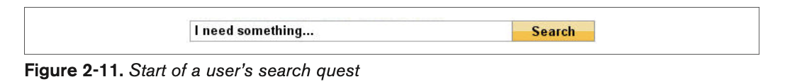
Retrieval and Ranking (1)
For most searchers, the quest for an answer begins as shown in Figure 2-11.
The next step in this quest occurs when the search engine returns a list of relevant pages on the Web in the order it believes is most likely to satisfy the user.
This process requires the search engines to scour their corpus of hundreds of billions of documents and do two things:
first, return only the results that are related to the searcher’s query;
and second, rank the results in order of perceived importance (taking into account the trust and authority associated with the site). It is both relevance and importance that the process of SEO is meant to influence.

Slide 15
Retrieval and Ranking (2)
Relevance is the degree to which the content of the documents returned in a search matches the user’s query intention and terms.
The relevance of a document increases if the page contains terms relevant to the phrase queried by the user, or if links to the page come from relevant pages and use relevant anchor text.
You can think of relevance as the first step to being “in the game.” If you are not rele- vant to a query, the search engine does not consider you for inclusion in the search results for that query

Slide 16
Retrieval and Ranking (3)
Importance refers to the relative importance, measured via citation (the act of one work referencing another, as often occurs in academic and business documents), of a given document that matches the user’s query.
The importance of a given document increases with every other document that references it. In today’s online environment, citations can come in the form of links to the document or references to it on social media sites
. Determining how to weight these signals is known as citation analysis.
You can think of importance as a way to determine which page, from a group of equally relevant pages, shows up first in the search results, which is second, and so forth.
The relative authority of the site, and the trust the search engine has in it, are significant parts of this determination.
Of course, the equation is a bit more complex than this, and not all pages are equally relevant. Ultimately, it is the combination of relevance and importance that determines the ranking order

Slide 17
Retrieval and Ranking (4)
Importance and relevance aren’t determined manually (those trillions of man-hours would require Earth’s entire population as a workforce).
Instead, the engines craft careful, mathematical equations—algorithms—to sort the wheat from the chaff and then rank the wheat in order of quality.
These algorithms often comprise hundreds of components. In the search marketing field, they are often referred to as ranking factors or algorithmic ranking criteria.

Slide 18
Evaluating Content on a Web Page (1)
Search engines place a lot of weight on the content of each web page. After all, it is this content that defines what a page is about, and the search engines do a detailed analysis of each web page they find during their crawl to help make that determination.
You can think of this as the search engine performing a detailed analysis of all the words and phrases that appear on a web page, and then building a map of that data for it to consider showing your page in the results when a user enters a related search query.
This map, often referred to as a semantic map, seeks to define the relationships between those concepts so that the search engine can better understand how to match the right web pages with user search queries.

Slide 19
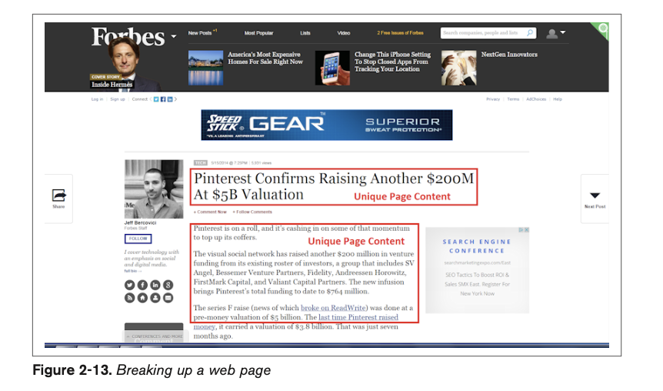
Evaluating Content on a Web Page (2)
If there is no semantic match of the content of a web page to the query, the page has a much lower possibility of showing up.
Therefore, the words you put on the page, and the “theme” of that page, play a huge role in ranking.
Figure 2-13 shows how a search engine will break up a page when it looks at it, using a page on the Forbes website.

Slide 20
Evaluating Content on a Web Page (3)
The navigational elements of a web page are likely similar across the many pages of a site.
These navigational elements are not ignored, and they do play an important role, but they do not help a search engine determine what the unique content is on a page.
To do that, the search engine focuses on the part of Figure 2-13 that is labeled “Unique Page Content.”
Determining the unique content on a page is an important part of what the search engine does. T
he search engine uses its understanding of unique content to determine the types of search queries for which the web page might be relevant.
Because site navigation is generally not unique to a single web page, it does not help the search engine with that task.

Slide 21
Evaluating Content on a Web Page (4)
This does not mean navigation links are not important—they most certainly are; how- ever, they simply do not count when a search engine is trying to determine the unique content of a web page, as they are shared among many web pages.
One task the search engines face is judging the value of content.
Although evaluating how the community responds to a piece of content using link analysis is part of the process, the search engines can also draw some conclusions based on what they see on the page.
For example, is the exact same content available on another website? Is the unique content the search engine can see two sentences long or 500 words long? Does the content repeat the same keywords excessively?
These are a few examples of factors the search engine can evaluate when trying to determine the value of a piece of content.

Slide 22
Understanding What Content Search Engines Can “See” on a Web Page (1)
Search engine crawlers and indexing programs are basically software programs. These programs are extraordinarily powerful. They crawl hundreds of trillions of web pages, analyze the content of all these pages, and analyze the way all these pages link to one another.
Then they organize this into a series of databases that can respond to a user search query with a highly tuned set of results in a few tenths of a second.
This is an amazing accomplishment, but it has its limitations. Software is very mechanical, and it can understand only portions of most web pages.
The search engine crawler analyzes the raw HTML form of a web page. If you want to see what this looks like, you can do so by using your browser to view the source.

Slide 23
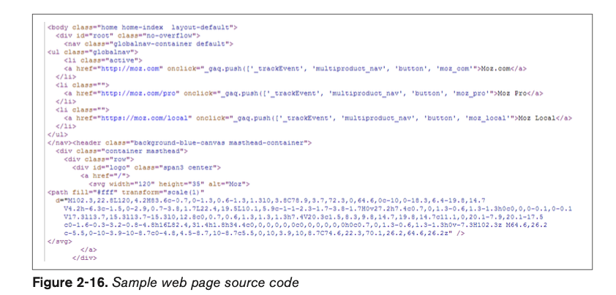
Understanding What Content Search Engines Can “See” on a Web Page (2)

Slide 24
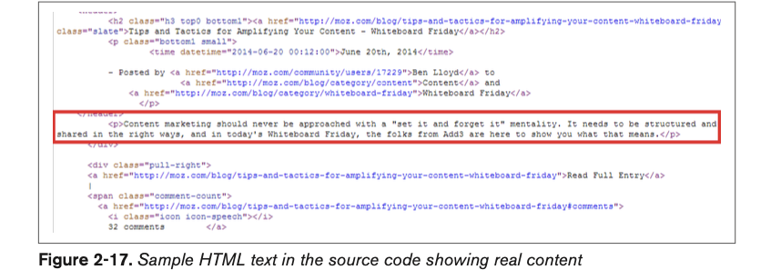
Understanding What Content Search Engines Can “See” on a Web Page (3)

Slide 25
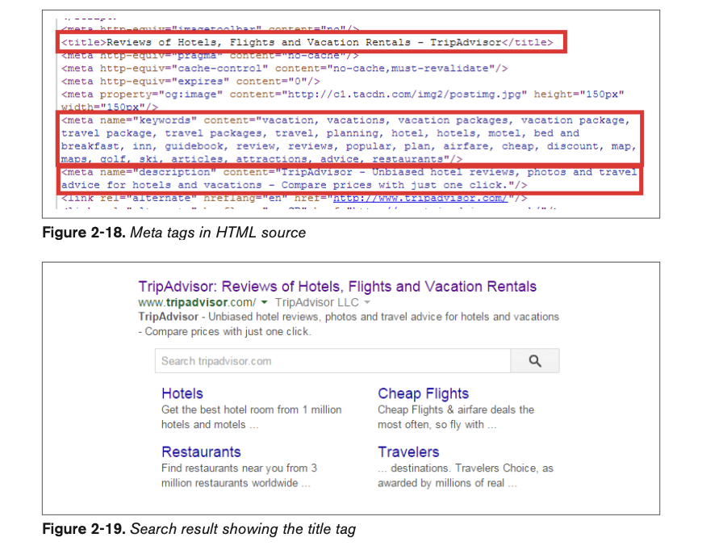
Understanding What Content Search Engines Can “See” on a Web Page (4)
Figure 2-18 shows the code that the crawler sees, using Trip Advisor as an example.
The first highlighted area in Figure 2-18 is for the <title> tag.
The <title> tag is also often (but not always) used as the title of your listing in search engine results (see Figure 2-19).

Slide 26
Understanding What Content Search Engines Can “See” on a Web Page (5)
In addition to page titles, search engines previously used the meta keywords tag.
This is a list of keywords that you wish to have associated with the page. Spammers (people who attempt to manipulate search engine results in violation of the search engine guidelines) ruined the SEO value of this tag many years ago, so its value is now negligible, as search engines don’t use it anymore.
Spending time on meta keywords is not recommended because of the lack of SEO benefit.
The second highlighted area in Figure 2-18 shows an example of a meta keywords tag.
Search engines also read the meta description tag (the third highlighted area in the HTML source in Figure 2-18). However, the content of a meta description tag is not directly used by search engines in their ranking algorithms.

Slide 27
Understanding What Content Search Engines Can “See” on a Web Page (5)
Nonetheless, the meta description tag plays a key role, as search engines often use it as a part or all of the description for your page in search results.
Therefore, a well-written meta description can have a significant influence on how many clicks you get on your search listing, and the click-through rate on your search listing can impact your ranking.
As a result, time spent on meta descriptions is quite valuable.

Slide 28
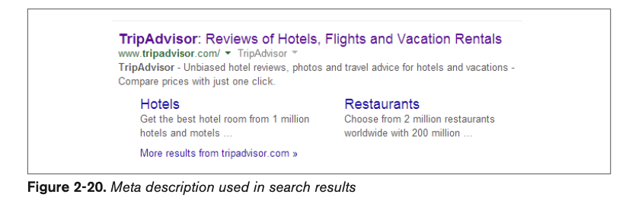
Understanding What Content Search Engines Can “See” on a Web Page (6)
Figure 2-20 uses a search on trip advisor to show an example of the meta description tag being used as a description in the search results.

Slide 29
Understanding What Content Search Engines Can “See” on a Web Page (7)
The user’s keywords are typically shown in boldface when they appear in the search results (sometimes close synonyms are shown in boldface as well).
As an example, in Figure 2-20, TripAdvisor is in boldface at the beginning of the description. This is called keywords in context (KWIC).

Slide 30
Understanding What Content Search Engines Can “See” on a Web Page (8)
A fourth element that search engines read is the alt attribute for images. The alt attribute was originally intended to allow something to be rendered for audiences who cannot view the images, primarily:
Vision-impaired people who do not have the option of viewing the images.
People who turn off images for faster surfing. This is generally an issue only for those who do not have a broadband connection.

Slide 31
Understanding What Content Search Engines Can “See” on a Web Page (9)
Support for the vision-impaired remains a major reason for using the alt attribute. You can read more about this by visiting the W3C’s Web Accessibility Initiative page.
Search engines also read the text contained in the alt attribute of an image tag (<img>). An image tag is an element that is used to tell a web page to display an image.
Another element that search engines read is the <noscript> tag.
Historically, the ability of search engines to read JavaScript was quite limited, but this has been changing over time and Google says they execute more JavaScript today.
However, a small percent- age of users do not allow JavaScript to run when they load a web page

Slide 32
Understanding What Content Search Engines Can “See” on a Web Page (10)
However, a small percentage of users do not allow JavaScript to run when they load a web page (our experience is that it is about 2%).
For those users, nothing would be shown to them where the JavaScript is on the web page, unless the page contains a <noscript> tag.
Here is a very simple JavaScript example that demonstrates this:
<script type="text/javascript">
document.write("It is a Small World After All!")
</script>
<noscript>Your browser does not support JavaScript!</noscript>
The <noscript> portion of this is Your browser does not support JavaScript!. In this example, you could also choose to make the <noscript> tag contain the text "It is a Small World After All!". The <noscript> tag should be used only to represent the con- tent of the JavaScript.

